Slide 1

Visible Light Communication(VLC)

Slide 2
Where and why to use VLC
Smart lighting in smart houses
Infrastructure and transportation:
(Traffic lights, Cars etc.)
Security purposes
Mobile connectivity
Bandwith problems

Slide 3
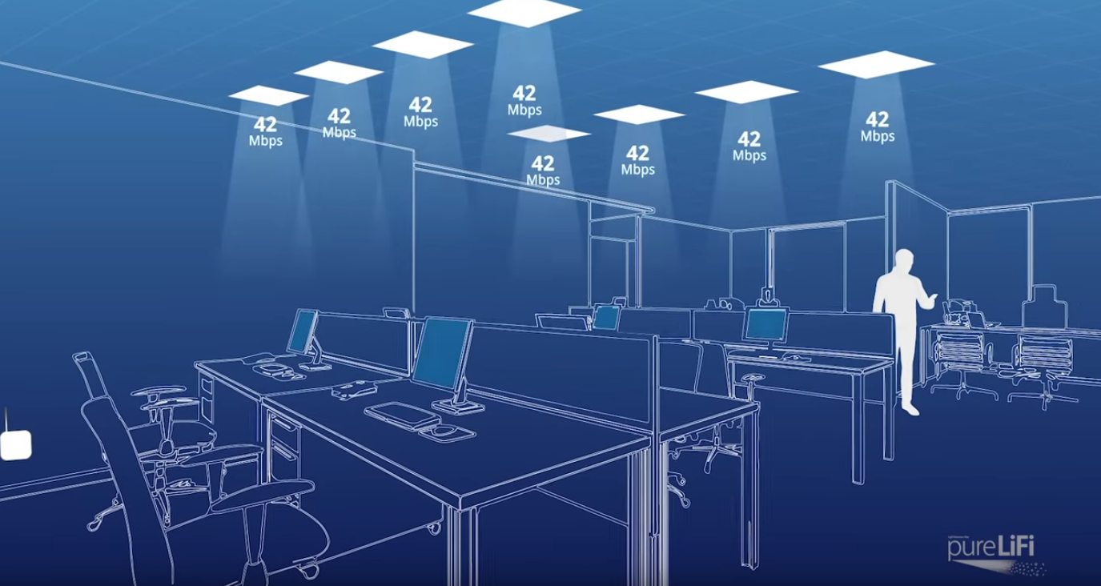
VLC in offices

Slide 4

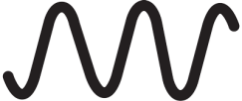
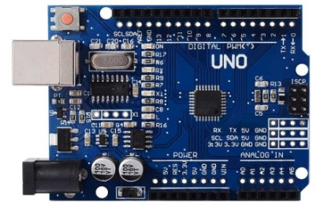
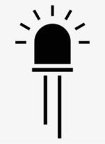


My project
0,1
640x480
10 FPS
0,1

Slide 5
Problems
*Arduino speed and memory
-16Mhz Oscillator
-32KB memory
*Analog to Digital Converter(ADC) speed
*Connection between arduino and computer on the receiver side

Slide 6
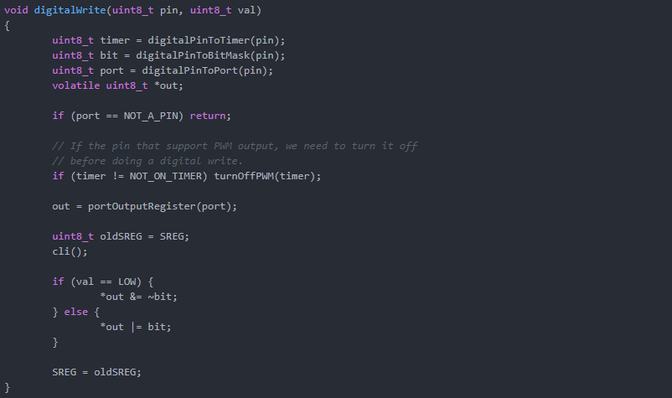
Solutions
Efficient coding

Slide 7
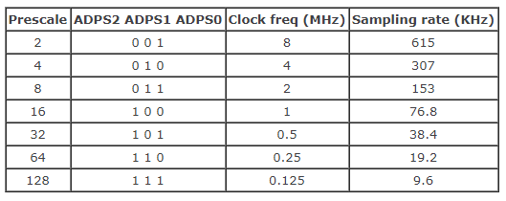
Solutions
Increasing sample rate of ADC
ADC clock is set to 16 MHz/128 = 125 KHz. Each conversion in AVR takes 13 ADC clocks so
125 KHz /13 = 9615 Hz.

Slide 8
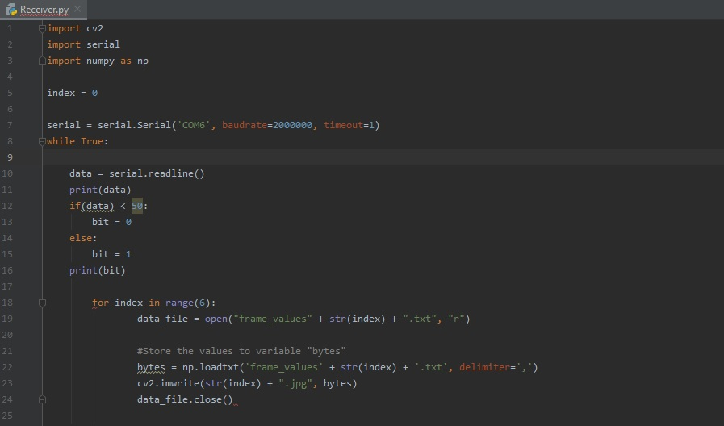
Solutions
Pyserial

Slide 9
Thank you for your time

